Slide 1

IMPROVEMENT OF STABILITY IN INTELLIGENT CONTROLLED MICROGRID USING VIRUTAL SYNCHRONOUS GENERATORS(VSG)
TEAM MEMBERS: AAMITH KISHORE T J- CB.SC.U4AIE24001 S PADMESH-CB.SC.U4AIE24044 SRI KRISHNA-CB.SC.U4AIE24054 B.YASWANTH REDDY-CB.SC.U4AIE24061 RAGAV S-CB.SC.U4AIE24041
SUBJECTS: Electrical and Electronics
Engineering and User Interface Design
1

Slide 2
CONTENTS
Introduction
Literature review
Research Gaps
Problem Statement and Proposed Solution
Block Diagram
Contents
Methodology
Results
Conclusions and Future Scope
References
2

Slide 3
INTRODUCTION
Renewable energy resources, such as solar and wind, are widely available and essential for a sustainable future. Microgrids are designed to efficiently utilize these resources, providing localized power generation and reducing dependence on centralized grids. However, due to the variable nature of renewable energy and the absence of inherent stabilizing mechanisms, microgrids face challenges in maintaining stable frequency and voltage, managing sudden changes in power demand or supply, and ensuring consistent and reliable operation. These issues can impact the overall performance and efficiency of the Microgrid.
3

Slide 4
LITERATURE REVIEW
S .No | Title | Year | Methodology/Techniques | Key Contributions
1 | Virtual Synchronous Machines: A New Control Strategy for Grid Stability | 2012 | Simulation-based analysis | Introduced VSG concept, demonstrating improved frequency stability and damping assistance.
2 | Advanced Droop Control for Virtual Synchronous Generators | 2014 | Experimental validation with microgrid tests | Developed an enhanced droop control technique improving dynamic response and power-sharing.
3 | Virtual Inertia Control in Renewable Energy Systems | 2015 | Comparative study | Analyzed different virtual inertia control strategies to enhance frequency stability in high-renewable systems.
4 | Grid-Forming Inverters Based on Virtual Synchronous Machines | 2016 | Hardware-in-the-loop (HIL) simulation | Evaluated VSG-based inverters in standalone and grid-connected modes, improving transient performance.
4

Slide 5
5 | Adaptive Control for Virtual Synchronous Generators | 2017 | Adaptive control algorithms | Proposed real-time adaptive VSG control strategies to optimize inertia and damping coefficients dynamically.
6 | Large-Scale Integration of VSGs: Challenges and Opportunities | 2018 | Case study on power networks | Investigated scalability concerns and proposed solutions for integrating VSGs into large power systems.
7 | Cybersecurity Risks in VSG-Based Power Grids | 2019 | Risk assessment framework | Identified potential cyber threats in VSG communication interfaces and suggested mitigation strategies.
8 | Field Test Validation of VSGs in Microgrids | 2020 | Field experiments in real-world microgrid | Demonstrated practical benefits of VSG technology in real-world microgrid applications.
9 | Optimization of Virtual Inertia in Renewable Energy Systems | 2021 | Machine learning-based optimization | Employed AI techniques to determine optimal virtual inertia values for grid stability.
10 | Future Directions in VSG Research and Development | 2023 | Review and roadmap analysis | Provided an overview of challenges and research gaps in VSG technology, highlighting future research directions.
5

Slide 6
KEYWORDS
Virtual Synchronous Generators (VSG)
Frequency Stability
Grid-Forming Inverters
Virtual Inertia Control
Droop Control Techniques
Renewable Energy Systems
Microgrid Stability
Hardware-in-the-Loop Simulation
Cybersecurity in Power Grids
Adaptive Control Algorithms
6

Slide 7
RESEARCH GAPS
Despite Virtual Synchronous Generators (VSGs) enhancing grid stability, there remain some key challenges. Optimal virtual inertia and damping parameter tuning is an open issue that affects transient response​. Scalability remains a challenge, with most of the work having been performed on small-scale test grids​. There are steady-state errors with existing droop control methods, which require adaptive methods​. Closing these gaps is necessary for large-scale VSG deployment in future grids.
7

Slide 8
PROBLEM STATEMENT
Microgrids face significant challenges, including frequency disturbances and voltage variations, due to the fluctuating nature of renewable energy sources and the lack of inherent inertia. These instabilities compromise power quality, system reliability. Traditional control methods are insufficient to address these issues effectively.
8

Slide 9
PROPOSED SOLUTION
To address the stability and reliability challenges of microgrids utilizing renewable energy, the Virtual Synchronous Generator (VSG) concept can be implemented. This approach mimics the behavior of traditional synchronous generators, providing essential stabilizing features such as inertia, damping, and droop control.
9

Slide 10
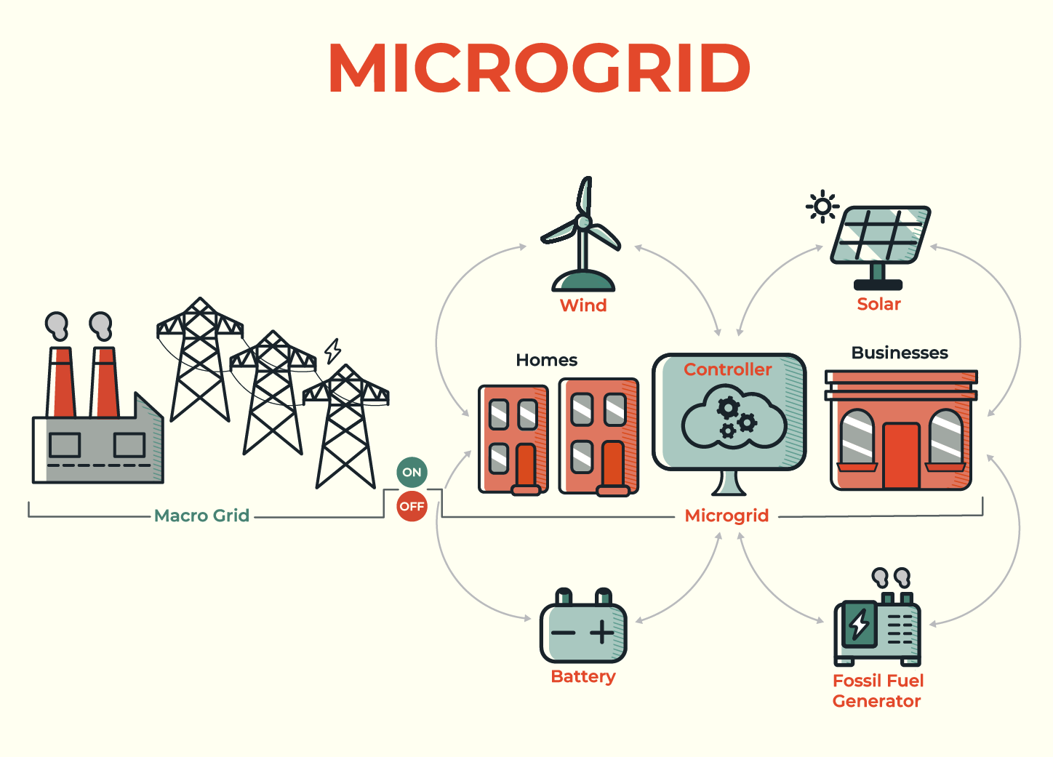
WHAT IS A MICROGRID AND HOW DOES IT WORK?
A microgrid is a group of interconnected loads and distributed energy resources that acts as a single controllable entity with respect to the grid.
10

Slide 11
WHAT IS VIRTUAL SYNCHRONOUS GENERATORS(VSG)?
A Virtual Synchronous Generator (VSG) is a power control technique used in inverter-based energy sources (such as solar panels, wind turbines, or battery storage) to mimic the behavior of a conventional synchronous generator.
The goal of a VSG is to enhance the stability and reliability of power systems by providing inertia and frequency support, similar to traditional rotating generators in power grids.
Features of VSG:
1.Emulation of Inertia-It used control algorithms to provide virtual inertia
2.Frequency and Voltage regulation
3.Droop control for Load sharing
11

Slide 12
DIFFERENCE BETWEEN TRADITIONAL SYNCHRONOUS GENERATORS AND VIRTUAL SYNCHRONOUS GENERATORS
A physical rotating machine with a rotor and stator, where mechanical energy is converted to electrical energy.
Traditional generators contribute directly to grid stability with their inertia
Frequency and voltage are regulated by the physical dynamics of the rotor and excitation system
VSGs rely on control algorithms to simulate the behavior of these parts.
VSGs rely on their virtual inertia (simulated through control systems) to provide similar stability.
Frequency and voltage are regulated using control algorithms that mimic the dynamics of a synchronous machine.
12

Slide 13
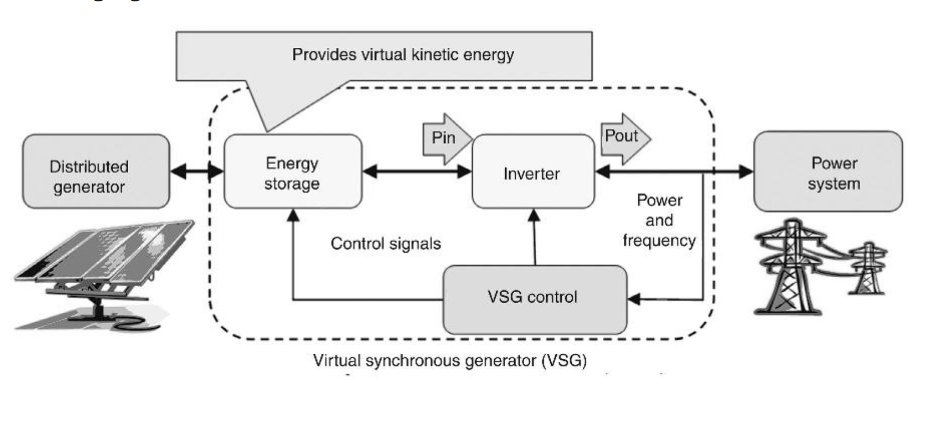
BLOCK DIAGRAM
13

Slide 14
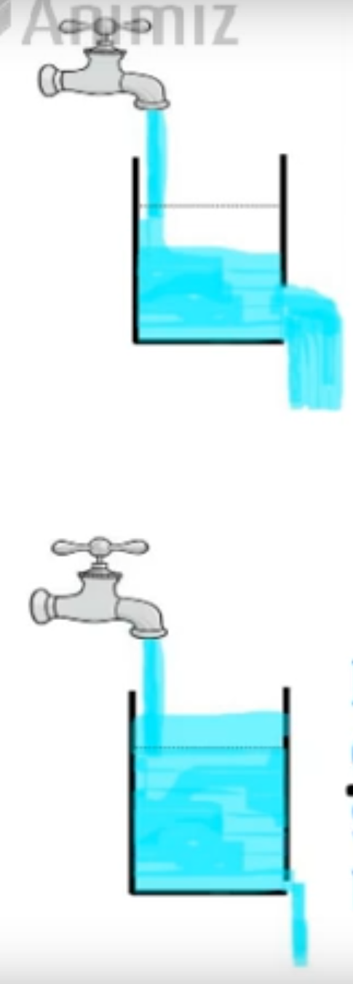
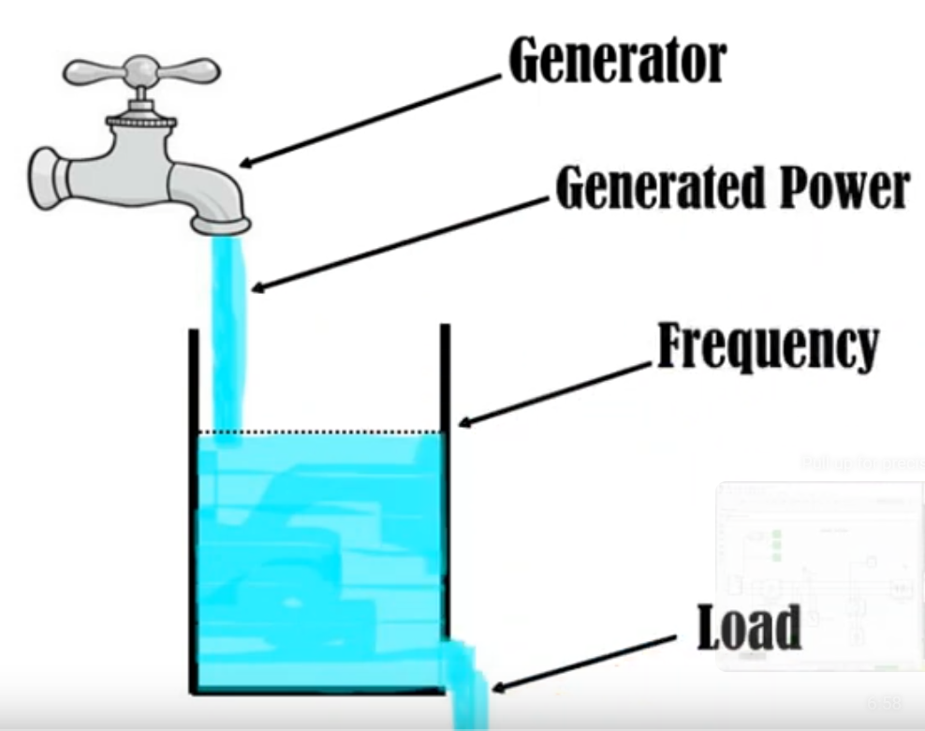
WHAT IS DROOP CONTROL AND HOW DOES IT WORK?
Droop control in a microgrid is a way of adjusting the output of power sources (like generators or inverters) to share the load evenly without needing communication between them.
To understand its working let’s consider an example,
14

Slide 15
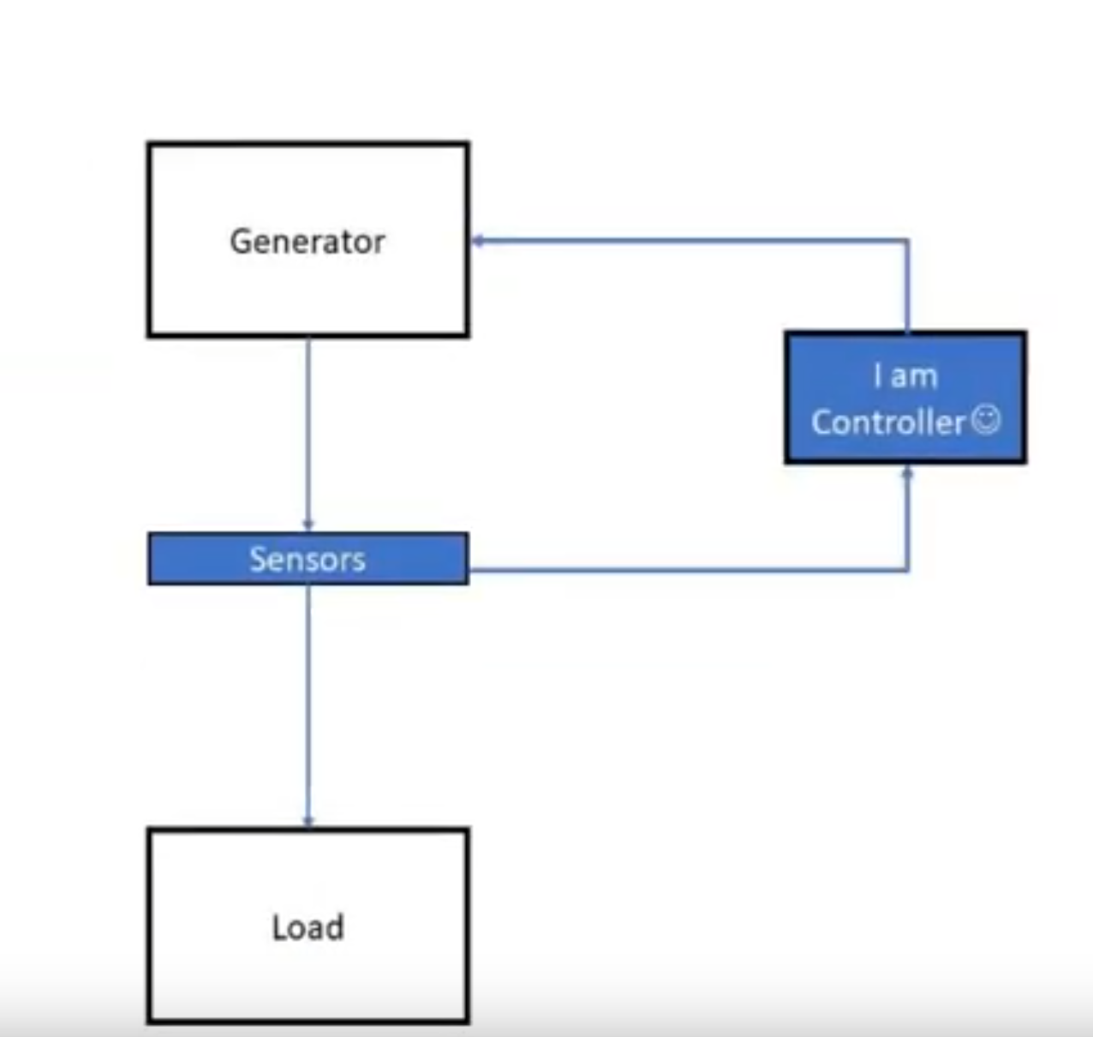
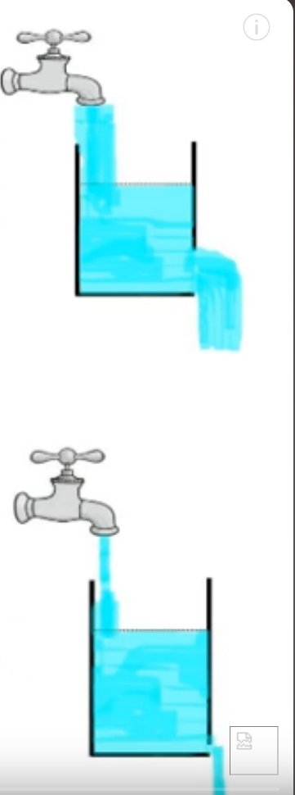
Example
DROOP CONTROLER
15

Slide 16
CONTROL LOOPS IN VSG
Active Power (P) control loop:
The active power control loop regulates the amount of real power (measured in watts, W) that a generator or inverter supplies to the microgrid.It plays a key role in maintaining the frequency stability.
HOW DOES IT WORK?
1. POWER REFERENCE INPUT- It gets the active power setpoint from the Microgrid energy management system.
2. Measurement & Comparison- The actual active power output is measured with the setpoint.
3. Control Action-The droop control mechanism adjusts the power output to match the reference.
4. Frequency Regulation- Since active power and frequency are closely related, this loop helps in maintaining grid frequency.
Reactive Power (Q) Control Loop
The reactive power control loop manages reactive power (Q) which is responsible for voltage regulation in the microgrid.
HOW DOES IT WORK?
1. Power Reference Input- A reference reactive power setpoint is provided by the EMS.
2. Measurement & Comparison- The actual reactive power output is compared with the setpoint.
3. Control Action-The droop control mechanism adjusts the inverter’s reactive power injection/absorption to maintain voltage stability.
4. Voltage Regulation: Since reactive power and voltage are closely related, this loop stabilizes the microgrid voltage.
16

Slide 17
METHODOLOGY
Modelling and design of Microgrid-Defining the microgrid structure for renewable structures, energy storage and loads. The microgrid with operate in both grid and island mode depending on the external power source availability.
VSG Model- This VSG model will contribute to the frequency and voltage regulation and ensure grid stability when operating in islanded mode.
Implementation of Droop Control:
Active Power Control Loop -Design a feedback control loop to regulate active power output. The loop will adjust the VSG's power output to match the load demand while compensating for any frequency deviations.
Reactive Power Control Loop-Design a feedback control loop to regulate the reactive power output. The reactive power control loop will adjust the VSG's output to maintain the system’s voltage at the desired level while responding to load variations.
17

Slide 18
CONTINUATION
Low pass Filter Integration-A low pass filter to eliminate high-frequency noise and prevent oscillations in the control loops. This filter will smooth out rapid fluctuations and ensure stability by allowing only low-frequency signals to affect the system.
Maximum Power Point Tracking (MPPT)-The MPPT will adjust the operating point of the renewable generation system to extract the maximum available power under varying environmental conditions.
Simulation- Will be done in Simulink
18

Slide 19
RESULT AND DISCUSSION
1. Improved Frequency Stability :
Observation: VSGs provide synthetic inertia, reducing frequency deviations.
Inference: Enhances system reliability and resilience.
2. Enhanced Power-Sharing with Droop Control :
Observation: Advanced droop control optimizes load sharing among multiple sources.
Inference: Leads to better dynamic response in microgrids.
3. Scalability Challenges :
Observation: Large-scale integration of VSGs may introduce control complexity.
Inference: Requires optimization of virtual inertia and adaptive strategies.
19

Slide 20
CONCLUSIONS AND FUTURE SCOPE
Conclusions:
1.VSGs significantly improve frequency stability and voltage regulation in microgrids.
2.Advanced control strategies enhance power-sharing and dynamic response.
3.Challenges remain in scalability, parameter optimization, and cybersecurity.
Future Scope:
1.Development of AI-based adaptive VSG control for real-time tuning.
2.Secure communication protocols for mitigating cybersecurity risks.
3.Integration of VSGs in large-scale renewable grids for higher resilience.
20

Slide 21
REFERENCES
https://www.researchgate.net/publication/334767695_Small_signal_stability_improvement_of_a_microgrid_by_the_optimized_dynamic_droop_control_method
https://ieeexplore.ieee.org/document/10000104
https://ieeexplore.ieee.org/document/5638946
https://ieeexplore.ieee.org/document/4596800
21

Slide 22
THANK YOU
22

